Slide 1




User Models, Metrics and Measures of Search: A Tutorial on the CWL Evaluation Framework ACM CHIIR UMMMS 2021
by
Leif Azzopardi, Alistair Moffat, Paul Thomas and Guido Zuccon

Slide 2




Who are we?
Leif Azzopardi, @leifos
Associate Professor, University of Strathclyde Studying how information systems shape and influence people and society with models of user behavior, interaction and performance.
Alistair Moffat
Professor, University of Melbourne Searching for better information retrieval metrics, text and index compression methods, and information retrieval heuristics.
Paul Thomas, @pt_ir
Senior Applied Scientist, Microsoft Bing
Studying how people use search systems, and using that to evaluate current systems and build new ones.
Guido Zuccon, @guidozuc
Associate Professor, University of Queensland
Researching and developing formal models of search, ranking, and research diversification, especially in the domain of e-health.

Slide 3
But, what about you?
Notes:
Who wants to model the user behavour?
Who wants to measure the system performance?
Who wants to decide what the system should do?

Slide 4
Evaluation
What is evaluation?
Measure the effectiveness, efficiency and cost of a system
Search Effectiveness: how good a system is in retrieving relevant documents
This is the focus of this tutorial
Search Efficiency: how fast a system is in retrieving documents
Often there is trade-off between effectiveness and efficiency
Cost: how much does it cost to run the system ($$, Kw/h, etc)
Usually cost is determined by the desired level of effectiveness and efficiency

Slide 5
Why do we want to Evaluate?
Say whether the system is any good
Compare two systems, so as to choose the “best” (or best fit)
Understand where the system succeeds and where it fails (diagnostic)
(What about evaluating users?)

Slide 6
Test your evaluation intuition
Which SERP is better?
SERP one
SERP two
Good
Bad
Good
Bad
Bad
Bad
Bad
Good
Bad
Bad
Bad
Bad

Slide 7
Test your evaluation intuition
Which SERP is better?
SERP one
SERP two
Good
Good
Good
Good
Bad
Bad
Bad
Good
Bad
Bad
Bad
Bad
Notes:
Two is at least as good as one
RR says they’re the same

Slide 8
Test your evaluation intuition
Which SERP is better?
SERP one
SERP two
Bad
Good
Bad
Bad
Bad
Bad
Good
Bad
Good
Bad
Good
Bad
Notes:
P differs to RR for example
Depends on the searcher’s goal.
Like a five set tennis match, it ain’t over till its over.
Maybe it’s never over….

Slide 9
Metric Choices
There are lots!
P@k, precision at depth k: fraction of the top k which are relevant
RBP, rank-biased precision: geometrically-decreasing importance
RR, reciprocal rank: 1 / rank of the first relevant result
NDCG, normalized discounted cumulative gain: logarithmically-decreasing importance, and scaled by available relevance
AP: average of precision values, at positions where there’s relevance
And don’t forget: TBG, ERR, U-measure, Bejewelled, BPref, INSQ, INST…
Notes:
There are lots!
Many in use e.g. at TREC, in SIGIR papers; many many perpetrated in the literature (some by us)
And they all seem to have different units – more on this later
Lots of metrics: anything in common, any coherent way to talk about these?
Any way to discuss, trade off, choose?
Yes: examine the model underlying each

Slide 10
Metric Choices
Lots of metrics:
which metric is best?
which metric should I use?
anything in common, any coherent way to talk about these?
Any way to discuss, trade off, choose?
Yes: examine the model underlying each
In this tutorial, we introduce you to the C/W/L framework that allows you to understand, analyse and compare metrics
Notes:
There are lots!
Many in use e.g. at TREC, in SIGIR papers; many many perpetrated in the literature (some by us)
And they all seem to have different units – more on this later
Lots of metrics: anything in common, any coherent way to talk about these?
Any way to discuss, trade off, choose?
Yes: examine the model underlying each

Slide 11
Tutorial’s Motivations
To understand, build and apply …
Notes:
The tutorial aims to give you the toolboxs for guiding you among these decisions. And this toolbox is centered around economic models. But why Economics?
Economics …

Slide 12
Tutorial’s Goals
Give you the knowledge and skills to:
Explain the C/W/L framework and the different measurements it incorporates;
Explain the User Browsing Models (continuation functions)
Analyse existing metrics in light of C/W/L
Design a metric given the C/W/L framework
Learn to use the “cwl_eval” toolkit

Slide 13
Learning objectives of UMMMS 2021
formally define the C/W/L framework and how to calculate the Expected Utility of a result list;
define the User Browsing Models (continuation functions) of different metrics;
show how new metrics can be defined via the UBM;
explain how C/W/L framework can be extended to produce different measurements;
describe extensions to C/W/L to include snippet-based, session-based;
show how the C/W/L framework can be used to evaluate results and analyze Continuation functions, Weighting functions, and Last Likelihood functions;
use the “cwl_eval” toolkit to perform TREC-like evaluations on typical IR system experimental outputs.

Slide 14
Schedule

Slide 15
Course slides at:
https://ielab.io/tutorials/ummms2021
youtube channel

Slide 16
Introduction to Evaluation

Slide 17
Evaluation Measures
Measures make sense in the context of a task
A measure is a model — so you need to use the measure that best models the task you are considering
models the user satisfaction and behaviour

Slide 18
User Behavior and System Performance

Slide 19


Behavior and Performance
(2) Measure quality of output shown.
(1) Decide what items to show in response to user input.
Interaction
Observed
User Behaviors
System Output/Ranking
(3) Understand how users will response to changes.

Slide 20
Behavior and Performance
Models of
User Behavior
Predictions of
System Performance
Interaction
Observed
User Behaviors
System Output/Ranking
Predictions of
User Behavior
Model of
System Performance

Slide 21
Behavior and Performance
Models of
User Behavior
Predictions of
System Performance
Estimation of
Relevance /
Ranking
Interaction
Observed
User Behaviors
System Output/Ranking
Predictions of
User Behavior
Model of
System Performance

Slide 22









System ranking…
Users behaving…
Given a query, the system returns a ranked list of documents…
and the user inspects the top 10 documents…
then Precision at 10 = 4/10.
More precisely,
p@10 = 0.4 relevant docs / doc inspected
Model of User Behavior
Vary the model of user behavior
Prediction of System Performance
obtain different predictions of system performance
Notes:
P@10 = 0.4 relevant docs / doc inspect

Slide 23
Tasks and User Models
An evaluation measure is typically grounded on a task and a user model
Robertson, SIGIR 2008: “If we can interpret a measure (. . . ) in terms of an explicit user model (. . . ), this can only improve our understanding of what exactly the measure is measuring”
Task: what the objective of the user is
User Model: how the user behaves
Example: precision
Task: find relevant documents, without finding non-relevant ones
User Model: examine all documents retrieved by the search engine, without order

Slide 24
What is a model?
“a deliberate simplification of something complicated with the objective of making it more tractable” Frigg, Roman and Hartmann, Stephan, 2018. “Models in Science”, in The Stanford Encyclopedia of Philosophy.
“a physical, conceptual, or mathematical representation of a real phenomenon that is difficult to observe directly” Rogers, 2012. “Scientific modeling”, in Encyclopædia Britannica.
“A simplified description, especially a mathematical one, of a system or process, to assist calculations and predictions” OED, 2019.

Slide 25
Complex User Models
Maxwell, Azzopardi. "Agents, simulated users and humans: An analysis of performance and behaviour." CIKM, 2016.

Slide 27
Offline, Online Evaluation; User Studies
Effectiveness evaluation categorized in three broad classes: Offline, Online, User Studies
The evaluation methods we see here are offline methods: the system is not live, experiments are done through simulations.
They do not involve actual users
The topic of this tutorial
What if we want to test a system in production, live, as it gets used? Online evaluation!
Online evaluation: Test (or even train) using live traffic on a search engine
See offline video for pointers
Offline evaluation with users: User Studies — non-production systems, careful control on user, task, interactions, feedback
See offline video for pointers

Slide 28
Measuring a SERP: Offline/test collection metrics

Slide 29
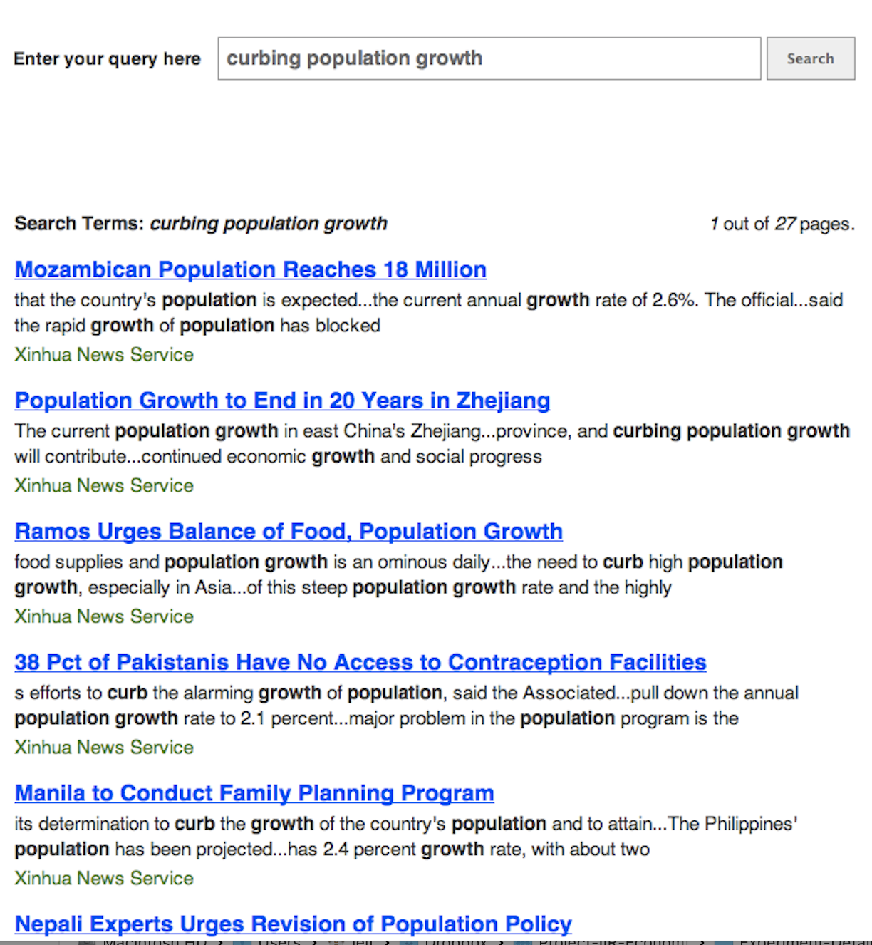
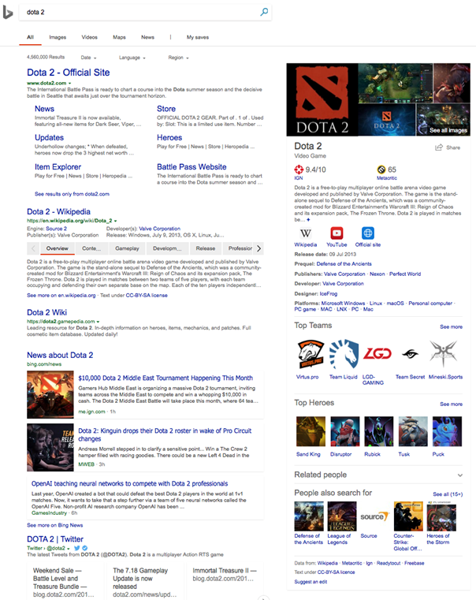
Our approximation of a SERP
☛
sort of
approximates
☛
Ranked list, top down
Web SERP
Homogenous elements

Slide 30


How we model assessing a ranking
Bad
Bad
Good
Fair
Good
Weight
×
Gain

Slide 31
Why offline evaluation
Cheap
Fast
Repeatable
Tells us about the real experience
?
Notes:
Good for repeated experimentation
We use them ‘cause we believe they have external validity; that is, that they tell us what the real experience would be like; they predict some aspect of the searchers’ experience
They are only as good as they are valid

Slide 32
Basic Evaluation Measures in IR

Slide 33
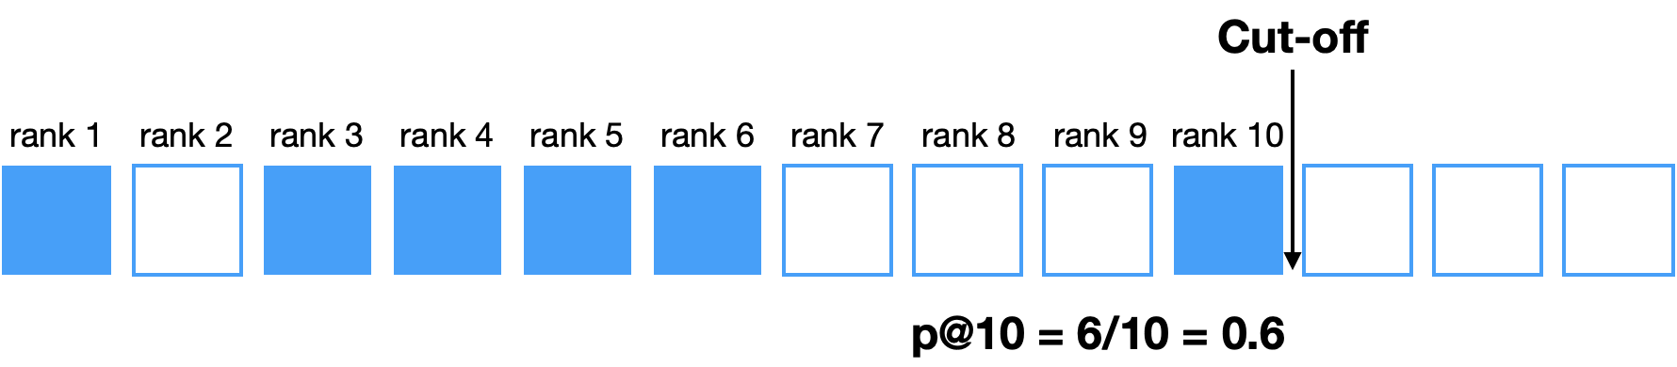
Precision at cutoff
Define the set of retrieved documents in function of ranking, i.e. fix a rank cutoff
then, compute precision up to that cutoff
e.g. p@10: precision up to rank 10 = (relevant docs retrieved up to rank 10) / 10

Slide 34
The user model of p@k
The user
examines all documents from position 1 to cut-off k
puts equal importance to any of the first k docs
wants as many relevant documents as possible
Thus:
The goal of the system is to find the highest number of relevant documents among the first k retrieved.
No distinction between differences in the rankings at positions 1 to k

Slide 35
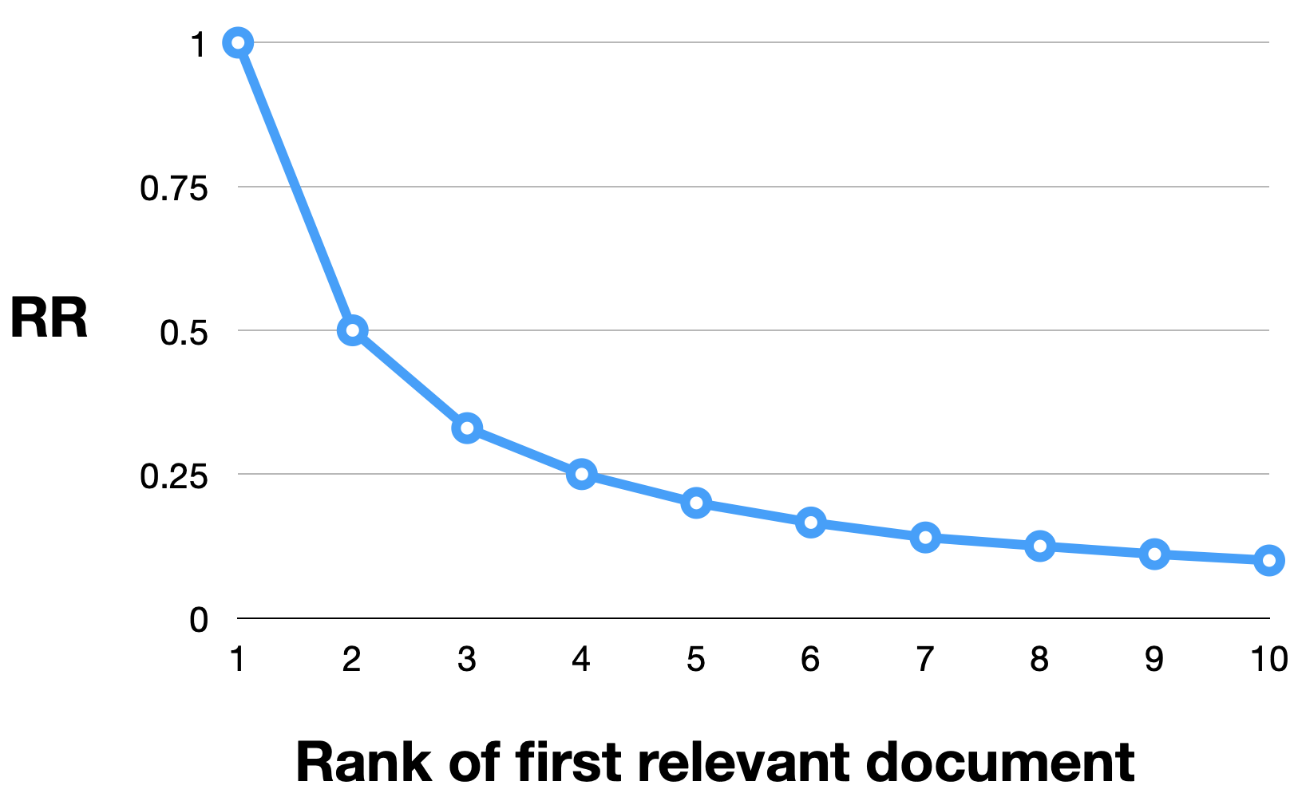
Reciprocal Rank (RR)
RR = 1 / rank_first_relevant
Increasingly lower RR value obtained by larger ranks
Task: find…
just one relevant document, OR
the only relevant document
User model: the user examines documents in order, and stops when finds the first relevant document

Slide 36
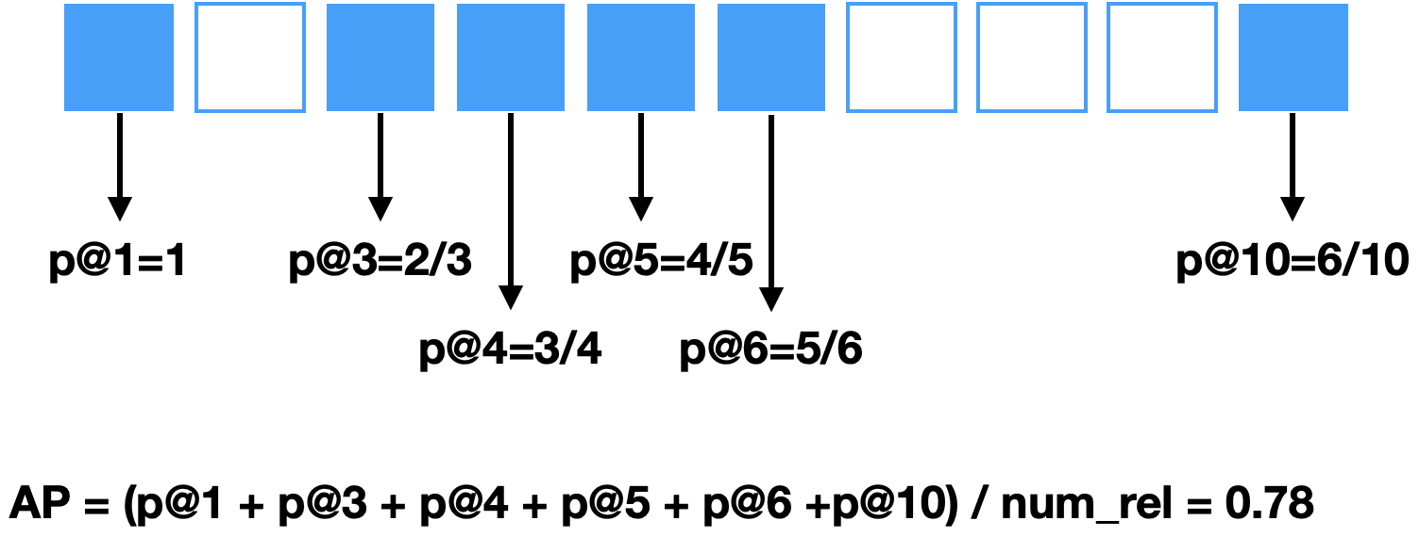
Average Precision (AP)
AP has 2 key steps
Sum the precision from the rank at which a relevant document is retrieved (each relevant doc produces an increase in recall)
and normalise by the number of known relevant documents

Slide 37
AP
AP value depends heavily on the highly ranked relevant documents: top-ranked documents are the most important
that is, AP is a top-heavy measure
Unless otherwise specified, it is usually computed over the entire ranking (i.e. commonly AP@1000)

Slide 38
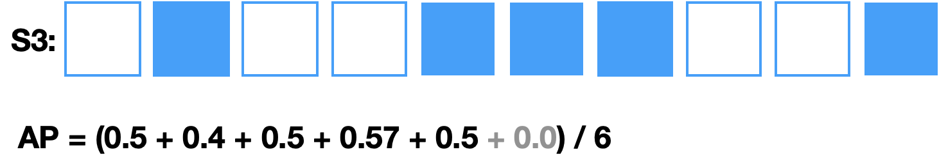
AP and relevant documents not retrieved
What if a relevant document in the collection is never retrieved by a system?
Contribution of the relevant, non-retrieved document to the sums of precisions is 0
But we still need to account for the relevant document when normalizing
e.g. assume 6 relevant document for query:

Slide 39
User models of AP
Moffat&Zobel, Rank-biased precision for measurement of retrieval effectiveness, TOIS 2008
Every time a relevant document is encountered, the user asks “Over the documents I have seen so far, on average how satisfied am I”
User writes a number on a piece of paper.
User continues to examine every document in the collection (only way to ensure all relevant docs have been seen)
At the end, user computes the average of the values they have written.

Slide 40
User models of (Probabilistic) AP
Dupret&Piwowarski, A User Behavior Model for Average Precision and its Generalization to Graded Judgments, SIGIR’10
The user decides the number n of relevant documents she needs to meet her information need.
She browses the result list sequentially.
She clicks on a document she examines with a probability that depends on the relevance of the document
0/1 in case of binary relevant
She ends her search as soon as she clicked on n relevant documents.
Notes:
Other probabilistic interpretations exist, like that due to Robertson in SIGIR’08

Slide 41
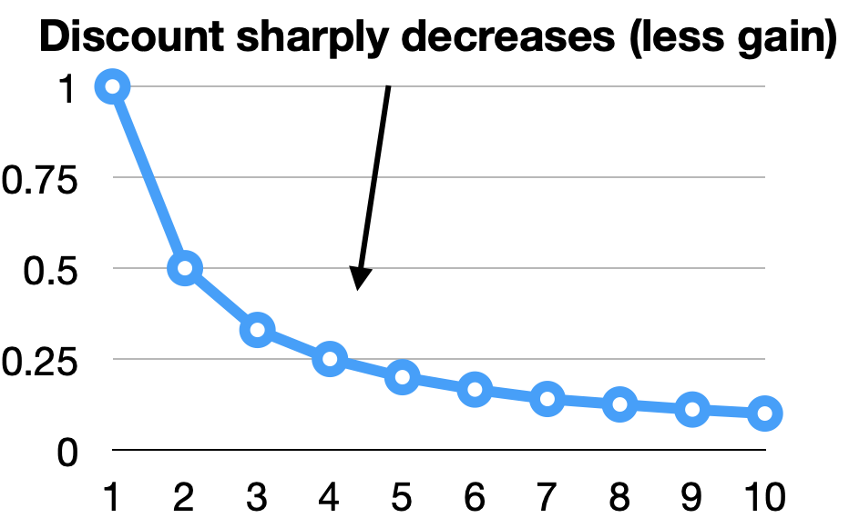
Gain&Discount metrics
Let’s revisit RR
The first relevant document can be thought as contributing a gain of 1
Every other relevant document retrieved contribute no gain (gain = 0)
Each rank is associated to a discount (d = 1/rank)
The user experience the gain of finding the relevant document, but decreased by the discount

Slide 42
Gain&Discount Framework
A metric may be defined in this framework
The metric is expressed as
the sum of the gain generated by relevant documents
weighted by the discount of the rank at which each relevant document is retrieved
the sum is up to rank k
may be normalised (1/N)
Carterette. "System effectiveness, user models, and user utility: a conceptual framework for investigation." SIGIR, 2011.

Slide 43

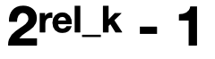
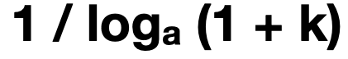
normalised Discounted Cumulative Gain (nDCG)
Normalisation
obtained by dividing DCG by ideal gain (perfect ranking for the query)
is useful when averaging across queries

Slide 44
Rank Biased Precision (RBP)
User Model of RBP:
a user always examines the first document in the list
then
examines the next with probability p
or stops the search with probability 1-p

Slide 45
Rank Biased Precision (RBP)
The user model can be used to define a discount: function of the probability of examining a document at rank i: d = pi-1
User receives a gain when examining a relevant document
Gain function: gain=1 when doc relevant; gain=0 when non-relevant g = ri
Notes:
Remind gain can also be not binary: graded relevance

Slide 46
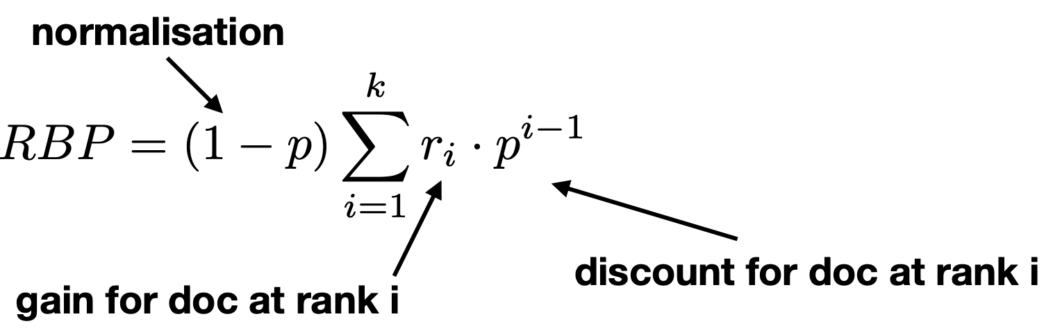
Rank Biased Precision (RBP)
Parameter 0<=p<=1 encodes user persistence or patience: the probability of continuing to the next rank
High p: persistent user; Low p: impatient user

Slide 47
The Cranfield Paradigm of Test Collections

Slide 48
Framework for evaluation: Cranfield/TREC
In practice, how do we go about using these measures?
The Cranfield/TREC experiments:
Formalises a way to experimentally evaluate IR systems
Predicates the development of test collections to measure IR effectiveness
A set of queries: sufficiently large & representative
A set of documents: large & representative
A set of relevance assessments for query-doc pairs
Need for completeness/exhaustivity?

Slide 49
TREC (and its sisters)
TREC (TExt Retrieval Conference - http://trec.nist.gov/) is an initiative from NIST (US gov agency) for the evaluation of IR systems
Other initiatives exist:
CLEF: based in Europe, initial focus on cross-lingual IR
NTCIR: based in Japan, focus on Asian languages
FIRE: based in India, focus on Indian languages
TREC is probability the most thorough and reliable: sizeable budgets for assessments; attract many participants; diversity in participants submissions and efforts

Slide 50
Example TREC Collections
Collection | Tasks | # documents | # queries
Clueweb09 | TREC Web Search | ~1B | TREC Web09-12: 200
Clueweb12 | TREC Web Search, CLEF eHealth 2016 | ~870M | TREC Web13-14: 100, CLEF2016: 300
New York Times Annotated Corpus | TREC Common Core’17, | ~1.8M | Common Core’17: 50
Washington Post Corpus (WAPO) | TREC Common Core’18, TREC News | 671,947 | Common Core’18: 50 News: 150
MS MARCO Passage Ranking | MS MARCO, TREC Deep Learning, TREC CAST | ~8.8M | MS MARCO: ~59K/6.9K dev in qrels, ~6.8K test in qrrels DL: 97 CAST: 50+25 topics (multiple sequential queries)
Update to modern ones

Slide 51
TREC Topic Example

Slide 52
Relevance Assessments
Obtaining relevance assessments is an expensive, time-consuming process
who does it?
what are the instructions?
what is the level of agreement?
TREC judgments
depend on task being evaluated (e.g., NIST assessors, medical experts, crowd)
Early collections had binary assessments; recent ones are graded
agreement good because of “narrative”

Slide 53
A qrel file
101 0 AP880212-0047 1
101 0 AP880219-0139 0
101 0 AP880219-0166 0
101 0 AP880222-0172 0
101 0 AP880223-0104 0
101 0 AP880229-0146 0
101 0 AP880314-0113 0
101 0 AP880314-0121 0
101 0 AP880314-0145 0
101 0 AP880320-0041 0
101 0 AP880321-0117 0
101 0 AP880323-0210 0
101 0 AP880323-0211 0
101 0 AP880324-0256 0
101 0 AP880326-0149 0
101 0 AP880329-0195 0
101 0 AP880329-0201 0
101 0 AP880330-0014 1
101 0 AP880330-0182 0
101 0 AP880404-0207 0
101 0 AP880414-0171 0
…………………

Slide 54
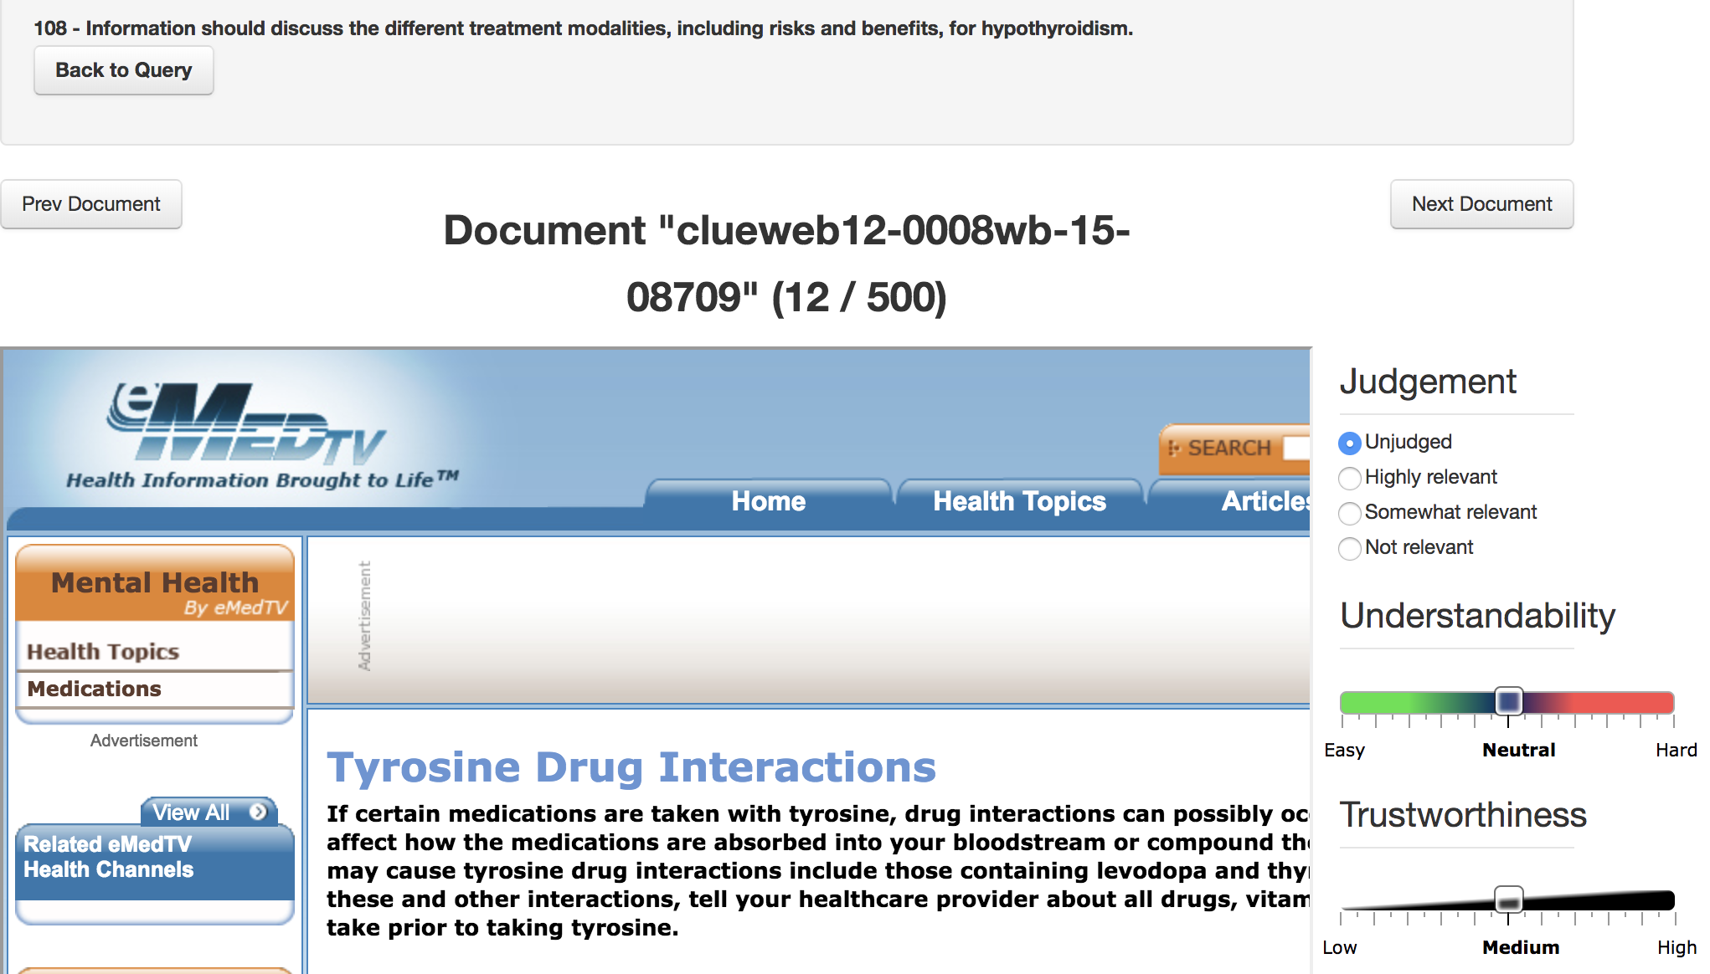
An example assessment exercise
Relevation! for CLEF 2017 eHealth: http://clef2017relevation.ielab.webfactional.com

Slide 55
A TREC Result File
101 Q0 WSJ870226-0091 1 0.7194 Brkly3
101 Q0 WSJ861216-0134 2 0.7078 Brkly3
101 Q0 AP890130-0077 3 0.7005 Brkly3
101 Q0 WSJ880523-0063 4 0.6999 Brkly3
101 Q0 WSJ881007-0136 5 0.6932 Brkly3
101 Q0 AP881030-0049 6 0.6912 Brkly3
101 Q0 AP880714-0012 7 0.6844 Brkly3
101 Q0 AP890426-0036 8 0.6844 Brkly3
101 Q0 AP881024-0011 9 0.6800 Brkly3
101 Q0 AP880608-0123 10 0.6766 Brkly3
101 Q0 WSJ870408-0045 11 0.6745 Brkly3
101 Q0 AP880314-0145 12 0.6743 Brkly3
101 Q0 AP890717-0130 13 0.6683 Brkly3
101 Q0 WSJ870715-0122 14 0.6663 Brkly3
101 Q0 AP891215-0115 15 0.6651 Brkly3
101 Q0 WSJ880712-0128 16 0.6614 Brkly3
101 Q0 AP890718-0020 17 0.6609 Brkly3
101 Q0 AP880611-0055 18 0.6601 Brkly3
101 Q0 DOE1-76-0712 19 0.6598 Brkly3
101 Q0 AP880610-0262 20 0.6585 Brkly3
…………………………..

Slide 56
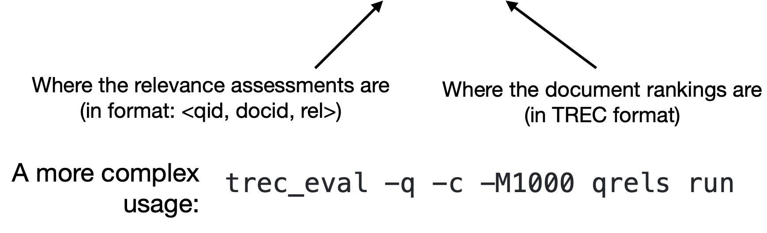
The trec_eval Tool
IR has a large number of evaluation measures: different measures for different domains, tasks, user models
There are standard/reference implementations
trec_eval is one such implementation of a number of IR measures: http://trec.nist.gov/trec_eval/
Usage:
trec_eval qrels run

Slide 57
trec_eval Tips & Tricks
-q: give evaluation for each query/topic
-J: Calculate all values only over the judged (either relevant or nonrelevant) documents
-l (labels): minimum relevance judgement value needed for a document to be relevant. Default is 1; larger values would make the measure more restrictive (e.g. 3 for only highly relevant)
-m: allows to select a measure, or a subset of measures
-m relstring: relevance values for first N (default 10, otherwise relstring.k) retrieved docs printed as string, e.g. 01010-11-0

Slide 58
trec-tools
open-source Python library for TREC-like campaigns; implements common activities:
Querying IR Systems: Benchmark runs from Indri, Terrier, PISA
Pooling Techniques: create pools using Depth@K, Comb[Min/Max/Med/Sum/ANZ/MNZ], Take@N, RRFTake@N, RBPTake@N
Evaluation Measures: P@k, R@k, AP, nDCG, Bpref, uBpref, RBP, uRBP. Break ties optios: doc score, doc ranking. Allows computation of residuals & unassessed documents, and standard evaluation plots for analysis
Correlation and Agreement Analysis: Pearson, Spearman, Kendall and τ-ap correlation between system rankings; Agreement between relevance assessment sets: Kappa or Jaccard
Fusion Techniques. For run fusion: Comb[Max/Min/Sum/Mnz/Anz/Med], RBPFusion, RRFFusion, BordaCountFusion.
https://github.com/joaopalotti/trectools

Slide 59
Pooling
Exhaustive assessments for all documents in a collection is not practical
A simple top-k pooling
top k results (for past TRECs, k varied between 50 and 200) from the rankings obtained by different search engines (or retrieval algorithms) are merged into a pool
duplicates are removed
documents are presented in some random order to the relevance judges
Produces a large number of relevance judgments for each query, although still incomplete

Slide 60
Incomplete Relevance Assessments
Modern test collections are formed by pooling a (hopefully) large & diverse set of runs from different systems, and assessing the relevance of these documents
Relevance assessment are incomplete: not all documents in the collection are assessed for each and every query
Relevant documents may exist that none of the systems that participated in the pool managed to retrieve
Questions to consider:
Is systems comparison reliable? if test collection is less incomplete, would the comparison b/w two systems be the same?
Is it reliable to compare a system that has been pooled and not-pooled system?
Is an incomplete test collection reusable?
Alistair will talk more about this

Slide 61
Meta-Evaluation: is our evaluation good?

Slide 62
Is our Evaluation Good?
How do we know if our measure is good?
How do we know if our collection is good?
Does our evaluation setup predict user behavior / user satisfaction?
Paul will discuss these, and other issues Leif will show how to try this out in practice

Slide 63
Metric Choices
Lots of metrics:
which metric is best?
which metric should I use?
anything in common, any coherent way to talk about these?
Any way to discuss, trade off, choose?
Yes: examine the model underlying each
C/W/L framework!
Alistair will next provide a framework to explore these questions
Notes:
There are lots!
Many in use e.g. at TREC, in SIGIR papers; many many perpetrated in the literature (some by us)
And they all seem to have different units – more on this later
Lots of metrics: anything in common, any coherent way to talk about these?
Any way to discuss, trade off, choose?
Yes: examine the model underlying each

